Slide 1

Service RDC
Kick-Off

Slide 2
Process Summary
Branches will no longer be responsible for ordering replenishment inventory for Service Technicians
Exceptions:
critical items such as Parts Pending
Job specific items for custom home/small business
Weekly replenishment will automatically be received onto the appropriate technicians truck via an Oracle automatic receipt process
Material Handlers will no longer be required to transact replenishment inventory for RDC program parts (eg. Oracle receipt, Oracle issue)
All Service technicians will receive a replenishment pack one time per week based on a regular schedule
Branches will be required to order and manage all other inventory & exceptions to the process
critical items such as Parts Pending
Job specific items for custom home/small business
If a Service tech needs a part not on the truck, they will return to the branch and have the warehouse provide it
Notes:
Read all bullets on the slide

Slide 3
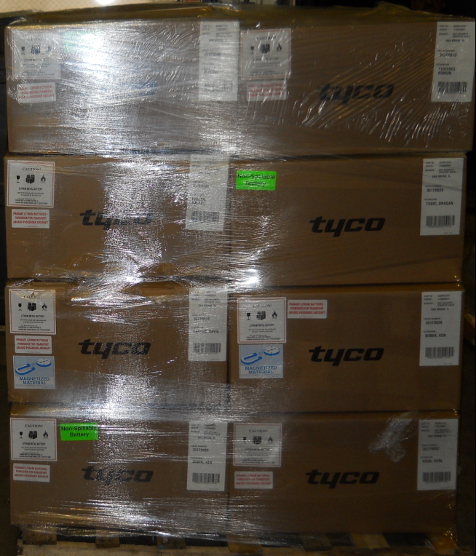

What to expect at the SSO
Shipments will be arriving at the branch via FedEx Freight
Shipment will be grouped on a pallet
Each shipment will come with a Bill of Lading
BOL will include a MASTER list of packing slips
Brown envelope glued to top of pallet underneath shrink-wrap
Notes:
Shipments will be arriving at the branch via FedEx Freight the day prior to the Installer scheduled replenishment day
Shipment will be grouped on a pallet which will be staged by the warehouse team
Each shipment will come with a Bill of Lading that depicts the number of pallets and boxes

Slide 4
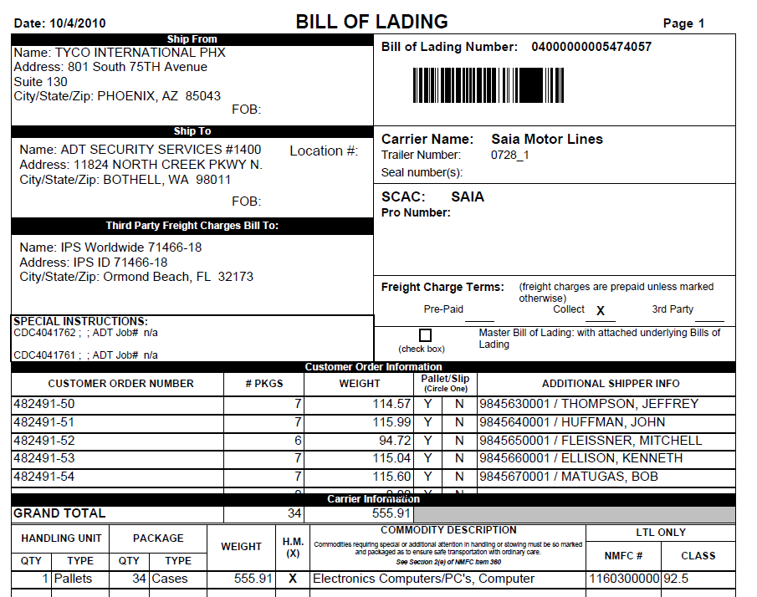
Bill of Lading
Every Shipment will come with a Bill of Lading that shows the number of boxes, pallets and installer names
Warehouse team will verify with FedEx
and refer back to the bill of lading if
there are issues with individual boxes
on pallets
Notes:
Read the slide and callout the example

Slide 5
Receipt of Shipment into SSO
Material Handler will receive the shipment and
Check for Damage
If damaged notify the OSTM who will file a claim following the process currently in place
Match carton count to Bill of Lading
If the shipment is under/over follow the steps for the defined process
Stage the material in tech area for pick up and parts validation
Delivery, check-in, pallet breakdown will take approx 20-30 minutes
Notes:
Read the slide

Slide 6
Branch Receipt of Shipment Over/Under Shipment at Dock
When a shipment does not contain the same number of boxes than listed on the Bill of Lading;
Validate each carton shipping label for tech and SSO to the Bill of Lading
If the SSO is incorrect, the Material Handler will ship to correct SSO via Standard Overnight
Material handler will notify OSTM
Adjust installer inventory to reflect shipment
Fill out and send DC Quality Tracking form
Notes:
Read the slide

Slide 7
Replenishment Day “1”

Slide 8

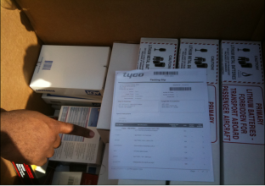
Replenishment “Day 1” Process
Each Tech will locate their box with their name on the outside and select the one that contains “Packing List Enclosed” sticker
Match the Case ID from box to the packing slip
Open one box at a time and remove all parts and organize by “like” parts
Carefully verify physical parts against packing slip noting any discrepancies
Be careful to check dunnage for small parts
Turn in signed packing slip to Material Handler
Discrepancies must be adjusted on the spot
Ensure Oracle adjustments for shipment discrepancies include “RDC Shipment Discrepancy” in the Oracle reference
After shipment discrepancies have been adjusted print the Oracle “Subinventory Quantities Report” (Material Handler)
Tech can be released
Notes:
Now that we’ve seen how easy the process is for the warehouse, let’s shift gears and talk about the installers process. The idea here is to create repetition in the process. For this initial replenishment there is an 8 step process. Going forward installers will only have to follow the first 4 steps in the process.
Read each one of the steps:
As soon as the meeting is adjourned, all installers and sub-contractors will proceed to the warehouse, find your replenishment box, and follow the 8 steps.

Slide 9
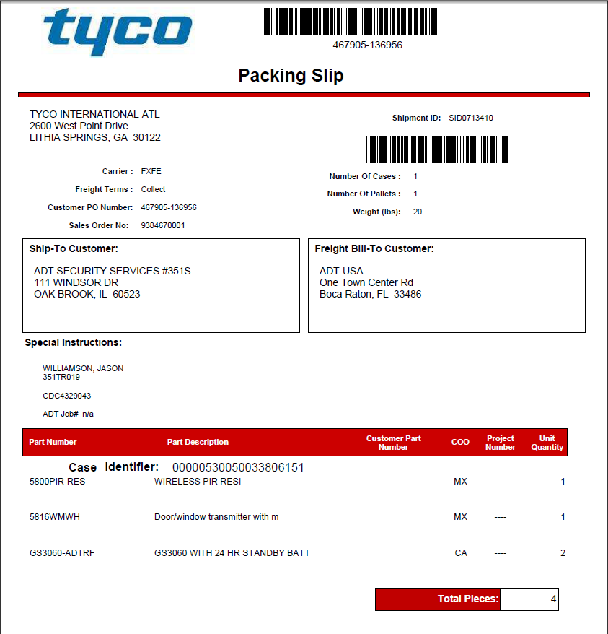


Packing Slip
Delivery Address
Tech Name and Truck#
Items and Quantities
Case ID#
This ties to the case# on the outside of the carton on the bottom of the shipping label. Which means the packing slip is actually by “carton”
Overall piece-count
1
2
4
00000530050043178965
3
5

Slide 10
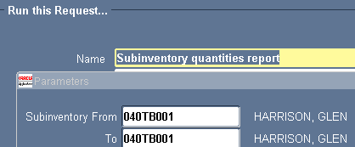
RDC Replenishment & Printing
Material Handler will be responsible for providing each tech with the Subinventory Quantities report after the installer has completed unpacking and loading their replenishment packs
Printing the Oracle Subinventory Quantities report
ADT Reports / Single Request / in “Name” field enter “Subinventory quantities report” then hit TAB on the keyboard (parameters will open)
Enter the To & From subinventory
Click “OK”
Click “Submit”
Notes:
Read the slide

Slide 11
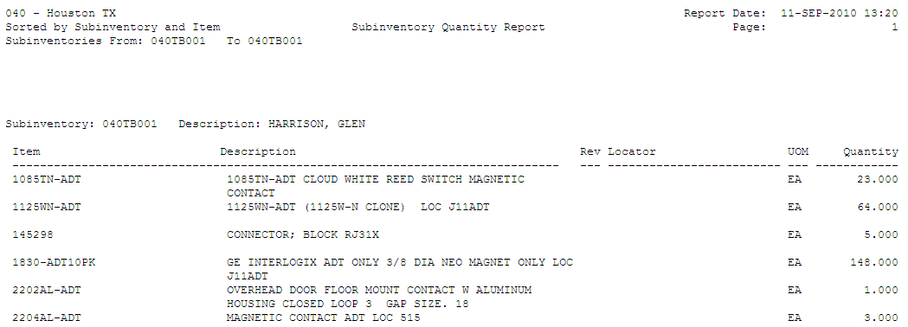
Using the report output
Truck# & Name
Part# & Description
Quantity showing on truck based on Oracle
1
3
2
Notes:
The report is very easy to use if you focus on these 3 items.
Make sure you are utilizing your report so quickly validate your truck sub-inventory and name are correct on the report
Match the item/part number and description
Match the quantity on your truck
This step is designed to ensure that you leave here today with an accurate starting inventory count. While your counting your parts in the Quantity column, by item, all you have to do is let us know how many parts are actually on your truck. If there is a variance the warehouse team will get them fixed today.

Slide 12

Tech Pick Up - Over/Shortage
Overages will be reported to the Material Handler and the tech stock adjusted
Shortages will be adjusted and if the inventory is available at the warehouse a sub-inventory transfer to the tech truck will be performed
If the part is not available at the SSO, Tech and Material Handler will review inventory to determine if enough stock is on hand for the tech for the day and/or create an order local pickup
If it is determined that the Tech does not have enough equipment for the day then the calls may need to be rescheduled. The involvement of the Service Team Manager is required
Adjust inventory levels
to ensure accuracy
Notes:
Please read the slide

Slide 13
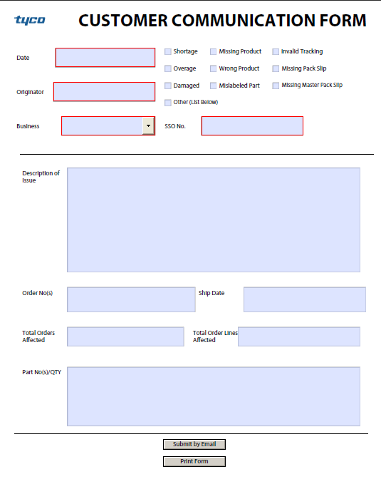
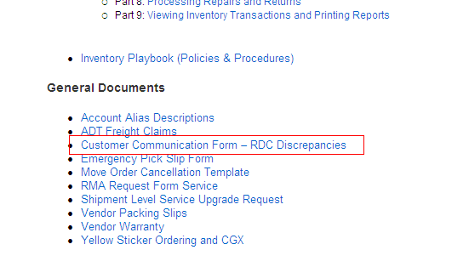
RDC Discrepancy form
The RDC Discrepancy form is located on the Job Aid page and should be used for shipment discrepancies such as overages & shortages.

Slide 14
Request for Additional Equipment
Tech in the field
Tech will contact Manager/Coordinator to request the parts who in turn will work with the Material Handler in locating the needed part
If part is available in warehouse, Team Manager/Coordinator will complete Parts Request Form and Material Handler will transfer part to truck. It is the responsibility of the Team Manager/Coordinator to coordinate with the technician for part delivery
If the warehouse does not stock it in the respective Resi Mains the branch will order it using the existing Parts Pending process
Oracle requisition denoting Parts Pending in the order, for overnight delivery either to the branch or the customer site directly
Notes:
Please Read the slide

Slide 15

Tech Pick Up Equipment Summary
Every Tech will be assigned a replenishment date by the branch and this will be their go forward replenishment day
The tech will come into the SSO on the assigned date and will match the Pick Slip against the shipment contents
Once the Pick Slip has been matched, the tech will sign the slip and turn the slip into the Material Handler
Any discrepancies will be immediately reported to the material handler with documentation
Monthly inventories of each truck with an accuracy of 98% or better will be required. Trucks not meeting the 98% minimum will be required will perform counts as frequently as required to maintain minimum accuracy levels
Notes:
Please read the slide.

Slide 16
Service RDC Planning Team
Service Planning Support
There is Service Planning inbox available to address branch inquiries regarding topics such as:
Min-Max levels
To be provided to team managers as part of this kick off. They will be subsequently posted on a SharePoint site.
Auto-Receipt issues
Branch ordering and receipt schedules will also be available on the Job Aid page.
Shipment related issues
E-mail:
RDC_Plan_RSB_SVC@ADT.com

